Slide 1


K. RAMAKRISHNAN COLLEGE OF TECHNOLOGY
(AUTONOMOUS), TIRUCHIRAPALLI
AGI1242 – Machine Learning Techniques
PACKAGE DAMAGE RISK PREDICTION
PRESENTED BY,
Joshica M – 2503811724322039
Kanishka T – 2503811724322040
Lethees Varman – 2503811724321048
Midhun Suresh – 2503811724321053
6/5/24

Slide 2
OBJECTIVE
To analyze shipment parameters such as product type, distance, handling stages and packaging to identify factors that influence package damage.
To design a machine learning model that predicts the probability of a shipment arriving damaged.
To classify shipments into Low, Medium or High damage risk categories using historical shipment records.
To help logistics companies take preventive action - such as better packaging or careful handling - for high-risk shipments.
To reduce transit damage, customer complaints and financial losses through early risk prediction.

Slide 3
PROBLEM IDENTIFICATION
Logistics companies currently have no reliable way to know in advance which shipments are most likely to arrive damaged.
Damage risk depends on multiple interacting factors - product fragility, transport distance, number of handling stages, packaging quality and past damage history - which are hard to assess manually.
Without early warning, damaged shipments are only discovered after delivery, leading to customer complaints, returns, replacement costs and loss of trust.
Example: A glassware shipment travelling 840 km through 6 handling stages with basic packaging and a high previous damage rate carries a 68% chance of damage - a risk that goes unnoticed under current practices.
There is a need for a predictive system that uses historical shipment records to flag high-risk shipments before dispatch.

Slide 4
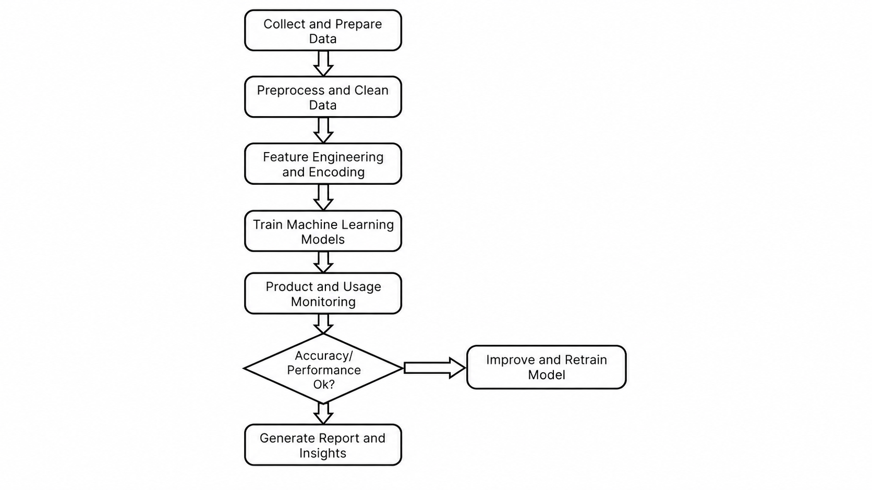
FLOW DIAGRAM

Slide 5
LITERATURE SURVEY
LINK

Slide 6
RESEARCH METHODOLOGY
Random Forest combines multiple decision trees to deliver high accuracy and robustness against overfitting.
Decision Tree offers a simple, fast and easily interpretable model for classifying shipment risk.
Support Vector Machine (SVM) finds an optimal boundary to separate risk classes, performing well on structured shipment data.

Slide 7
ALGORITHM 1: RANDOM FOREST
Principle:
An ensemble learning method that builds multiple decision trees on random subsets of shipment data and features, combining their predictions through majority voting.
Advantages:
High accuracy and resistant to overfitting.
Handles mixed data types (categorical and numerical) well.
Provides feature importance for identifying key damage drivers.

Slide 8
ALGORITHM 2: DECISION TREE
Principle:
A single tree-based model that splits shipment data on feature thresholds (distance, handling stages, packaging type) to classify damage risk.
Advantages:
Simple, fast to train and easy to interpret.
Visualizes decision logic clearly for reporting.
Requires little data preprocessing.

Slide 9
ALGORITHM 3: SUPPORT VECTOR MACHINE (SVM)
Principle:
A margin-based classifier that finds the optimal boundary separating Low, Medium and High risk shipment classes in feature space.
Advantages:
Effective on smaller, well-structured datasets.
Performs well with clear margins between risk classes.
Robust to outliers when properly tuned.

Slide 10
ALGORITHM COMPARISON
CRITERIA | RANDOM FOREST | DECISION TREE | SVM
Accuracy | High | Moderate-High | High
Overfitting | Low | Higher | Low with proper Tuning
Training Speed | Moderate | Fast | Moderate
Interpretability | Moderate | Very High | Low
Data Handling | Handles numerical & categorical data well | Handles Both | Works well with structured data
Dataset Suitability | Suitable for complex shipment patterns | Suitable for simple decision rules | Suitable for smaller structured datasets
Main Advantage | Robust and Accurate | Simple and easy to understand | Effective classification
Main Limitation | More computationally expensive | Can overfit | Requires careful parameter tuning

Slide 11
IDEA IMPLEMENTATION
Shipment Details Input:
The user enters details such as product type, distance, packaging type and number of handling stages.
Risk Analysis:
The system analyzes the entered shipment information using the trained machine learning model.
Damage Probability:
The model calculates the likelihood that the shipment may be damaged during transportation.
Risk Classification:
The shipment is classified into Low, Medium, or High damage-risk category.
Preventive Action:
For high-risk shipments, the system recommends preventive measures such as improving packaging or reducing handling stages.

Slide 12
MODULES
Data Collection
Gathers historical shipment records - product type, distance, handling stages, packaging type and past damage rates.
Data Preprocessing
Cleans raw data, handles missing values and encodes categorical attributes for model readiness.
Feature Engineering & Model Training
Extracts relevant features and trains Random Forest, Decision Tree and SVM models to learn damage patterns.
1
2
3
Risk Prediction Engine
Takes new shipment details as input and predicts the damage probability and risk category.
Reporting & Alert Dashboard
Displays predicted risk levels (Low / Medium / High) and generates alerts for high-risk shipments.
4
5

Slide 13
CONCLUSION
The Package Damage Risk Prediction system uses historical shipment records to predict the likelihood of a package arriving damaged before it is dispatched.
By analyzing factors such as product type, distance, handling stages, packaging type and past damage rate, the Random Forest model classifies shipments into Low, Medium or High risk categories.
This enables logistics companies to take preventive measures - such as upgrading packaging or reducing handling stages - for high-risk shipments, reducing damage costs and improving customer satisfaction.
The system can be further enhanced by incorporating real-time IoT sensor data, weather conditions and carrier-specific handling patterns for even more accurate predictions.

